Slide 1
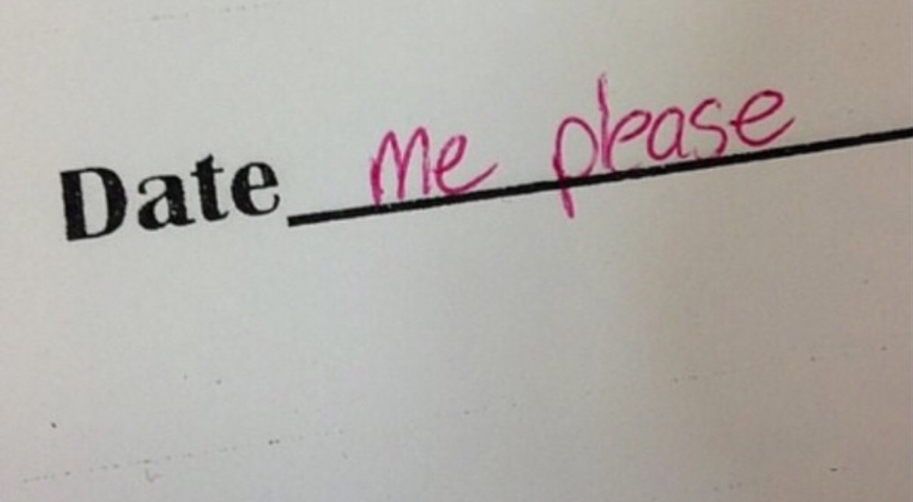

Dec. 5, 2019
Blind Dating Analysis
Sangseok Lee

Slide 2

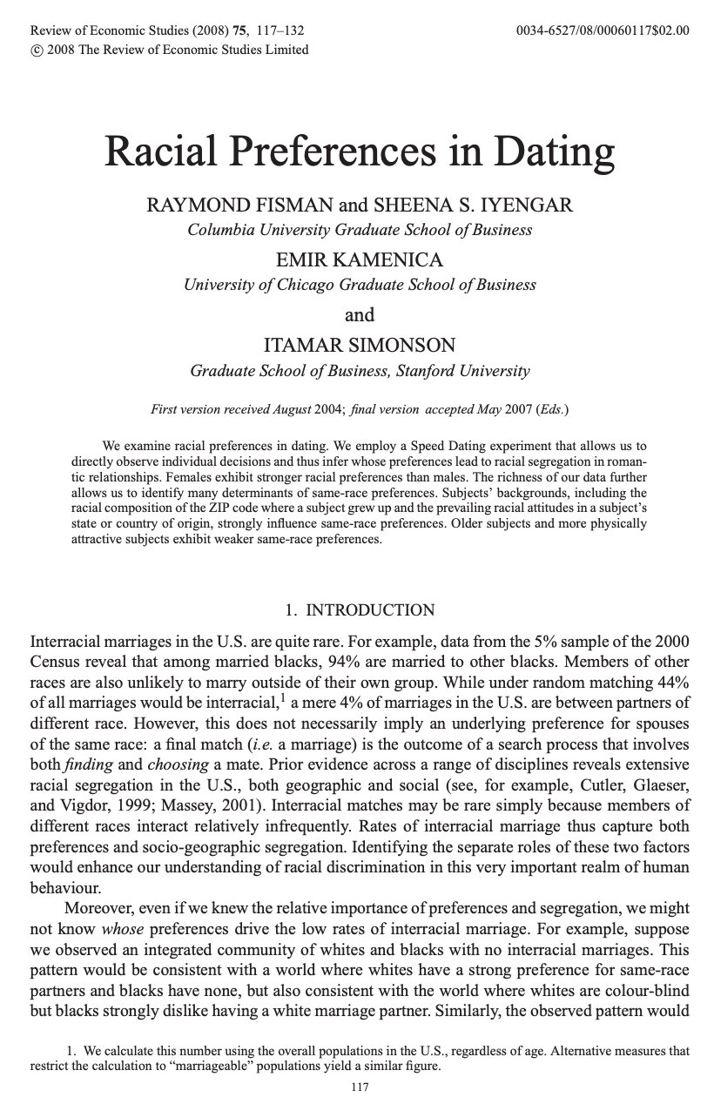
Dataset
Group ☓ 21
8378 rows, 195 var.
☓ 10
☓ 10
Joseph
Attractive
Shared
Values
Sincere
Ambitious
Fun
Inteligent

Slide 3
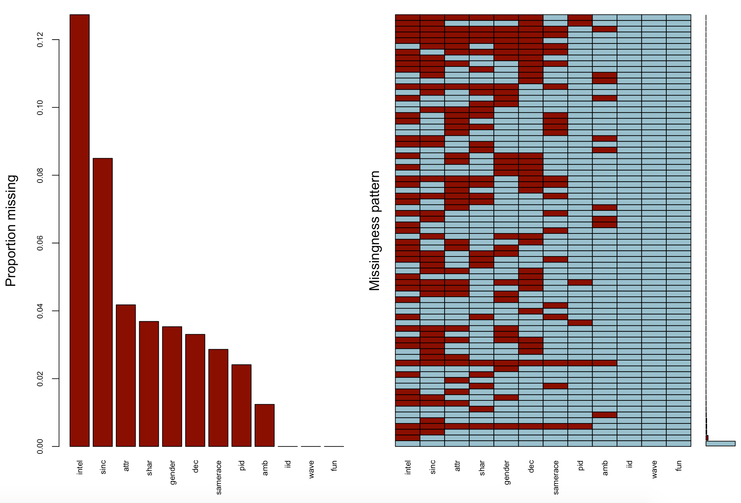
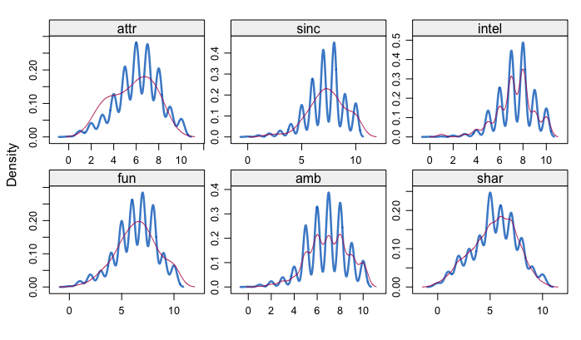

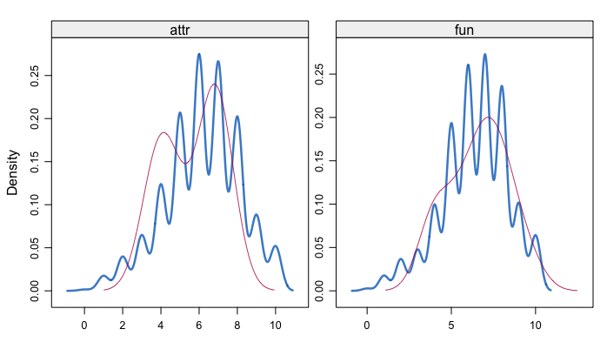
Missing data = 20% of total data
1. Imputed all missing data with pmm
2. Removed subjective(personal) data : 15% of total data
And imputed only attr, fun variables with norm

Slide 4
Purpose of study
1. What positive factors make people decide to meet?
2. What positive factors make the real matching possible ?
Attractive
Shared
Values
Sincere
…
Partner’s
yes probability
Like
Ambitious
Fun
Inteligent

Slide 5
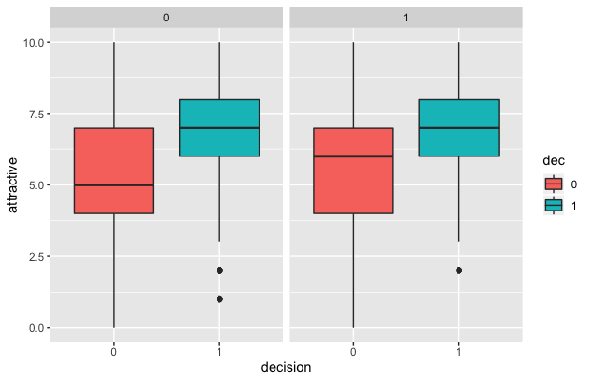
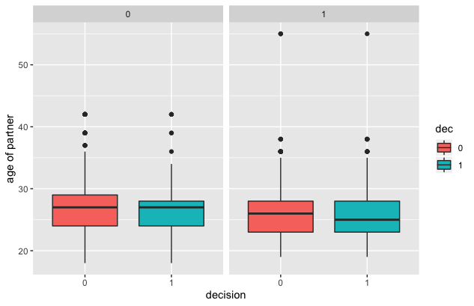
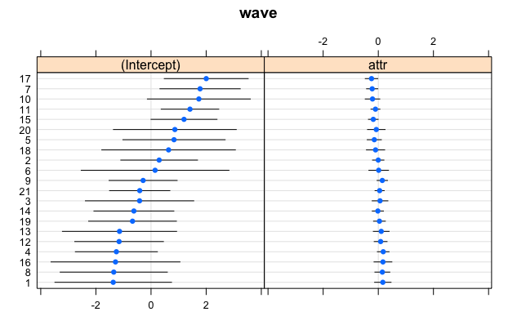
1. What factors make people decide to meet?
EDA
Female
Male
Female
Male
No
Yes
No
Yes
No
Yes
No
Yes

Slide 6
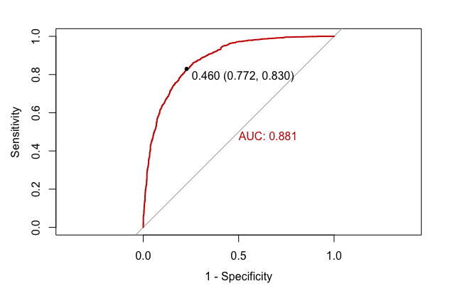
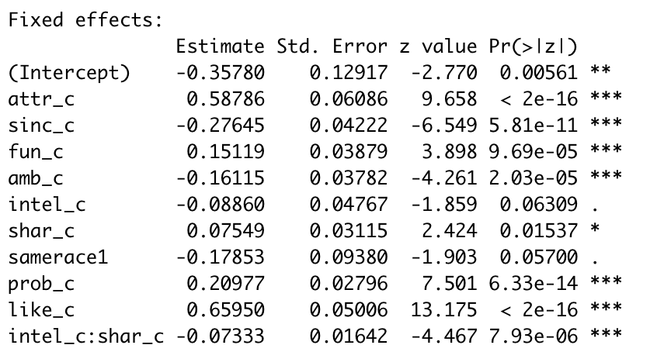
1. What factors make people decide to meet?
Result for male’s decision : Accuracy 80%
1) Male
Attractive
80%
Shared
Values
Sincere
-24%
7%
Ambitious
Fun
-14%
16%
Inteligent
-9%
-17%
23%
93%
Same
Race
Partner’s
yes probability
Like

Slide 7
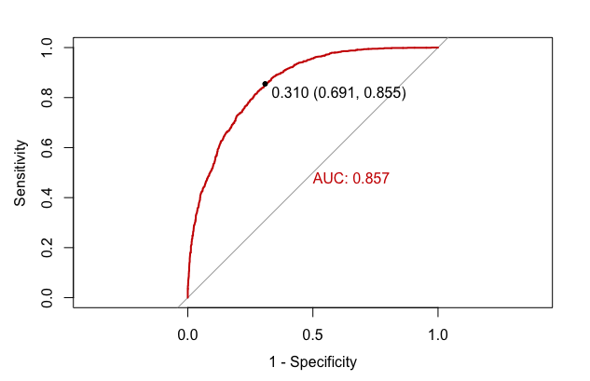
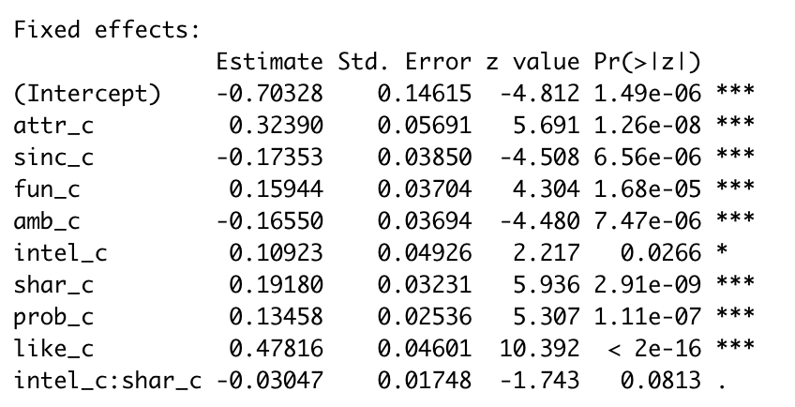
1. What factors make people decide to meet?
Result for female’s decision : Accuracy 0.78
2) Female
Attractive
38%
Shared
Values
Sincere
-16%
21%
Ambitious
Fun
-14%
17%
Inteligent
11%
14%
61%
Same
Race
Partner’s
yes probability
Like

Slide 8
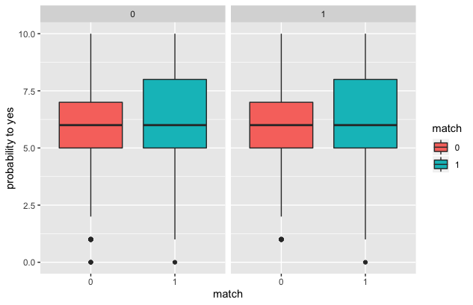
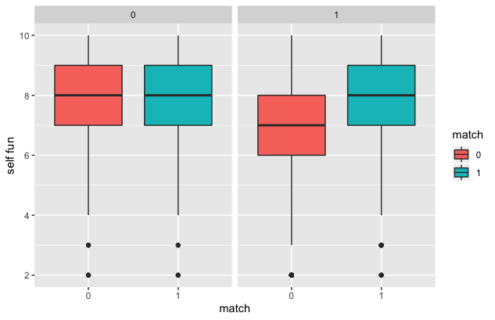
2. What factors make the real matching possible ?
EDA : the people who decided to meet
(50% of total data) + self_evaluation columns
+ partner’s rate
Female
Male
Female
Male
No
Yes
No
Yes
No
Yes
No
Yes

Slide 9
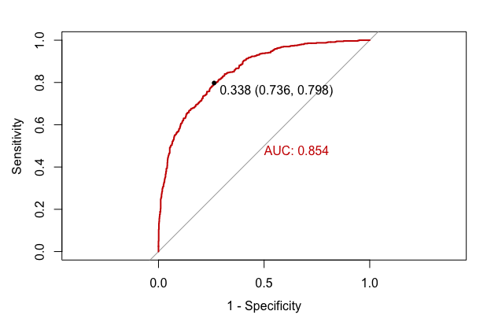
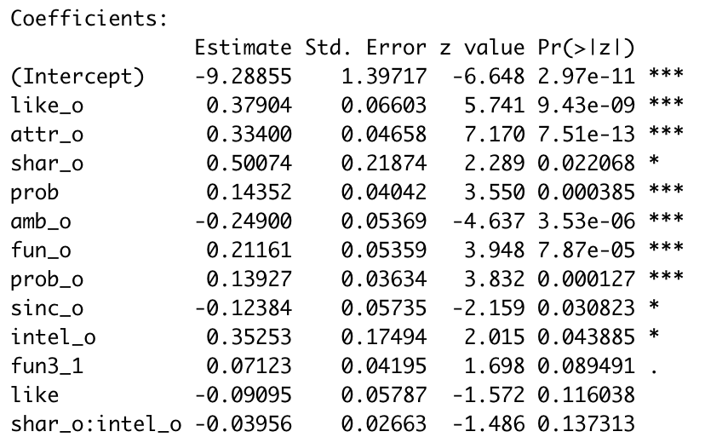
2. What factors make the real matching possible ?
Result for male’s partner decision : Accuracy 0.79
decision
Attractive
40%
Shared
Values
Sincere
-10%
65%
Ambitious
Fun
-22%
7%
Inteligent
42%
15%
-8%
15%
My Partner’s
yes probability
My Like
My Partner’s expectation
of my yes probability

Slide 10
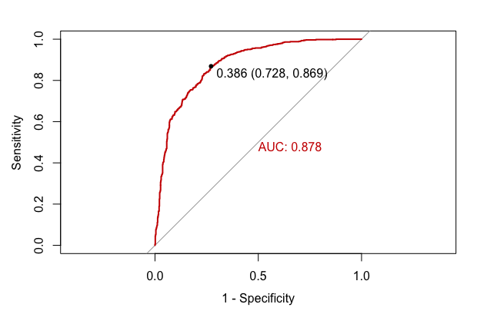
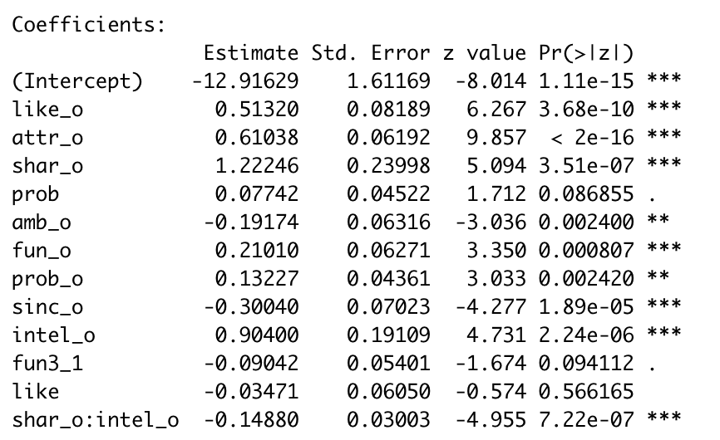
2. What factors make the real matching possible ?
Result for female’s decision : Accuracy 0.79
decision
Attractive
84%
Shared
Values
Sincere
-25%
340%
Ambitious
Fun
-18%
23%
Inteligent
247%
8%
-3%
14%
My Partner’s
yes probability
My Like
My Partner’s expectation
of my yes probability

Slide 11
Limitation & Conclusion
- 4 minutes are not enough to decide someone’s values
- 20% of total data has missing values
- no wonder that appearance is the best indicator during 4 minute meeting.
- However, because 4 minute talk is enough time to give first impression,
knowing what factors affect people the most is very important.
- It could be applied to the interview and elevator speech
- I hope you guys are in the area of True positive and True negative

